Slide 1
Chapter 6. Secure distributed middleware patterns
Dr. E.B.Fernandez

Slide 2
Distribution architectures
Ad hoc methods, used in early systems
Distributed objects: CORBA, Java RMI, Microsoft .NET Remoting. Still in use for special applications, e.g., RMI is used in Jini.
Web services: XML and REST (next chapter). Used to access services in cloud computing and to access web applications
Distributed middleware. Broker, MVC, Pipes and filters,…, used to implement distribution
Cloud Computing (Chapter 8). Distribution and centralization

Slide 3
Distributed Objects
Unit of distribution is an object
A local progran can apply operations to remote objects as if they were local (location transparency)
CORBA: has well developed security specifications
.NET Remoting: Windows-based approach, uses .Net security
RMI: based on Java, uses Java A&A
Combinations of the above with the Internet as communication vehicle

Slide 4
Client
OS
process
object request with parameters
Processor
CORBA
.NET
Remoting
Network
RMI
…
Objects
results
OS
Server
process
Processor
Objects

Slide 6
CORBA security
The Object Adaptor applies authorization for controlling access to remote object
The Broker pattern provides transparent access to remote objects and provides security functions
The Object Request Broker (ORB), a type of broker, can apply authentication and cryptographic defenses (message encryption and digital signatures)

Slide 7
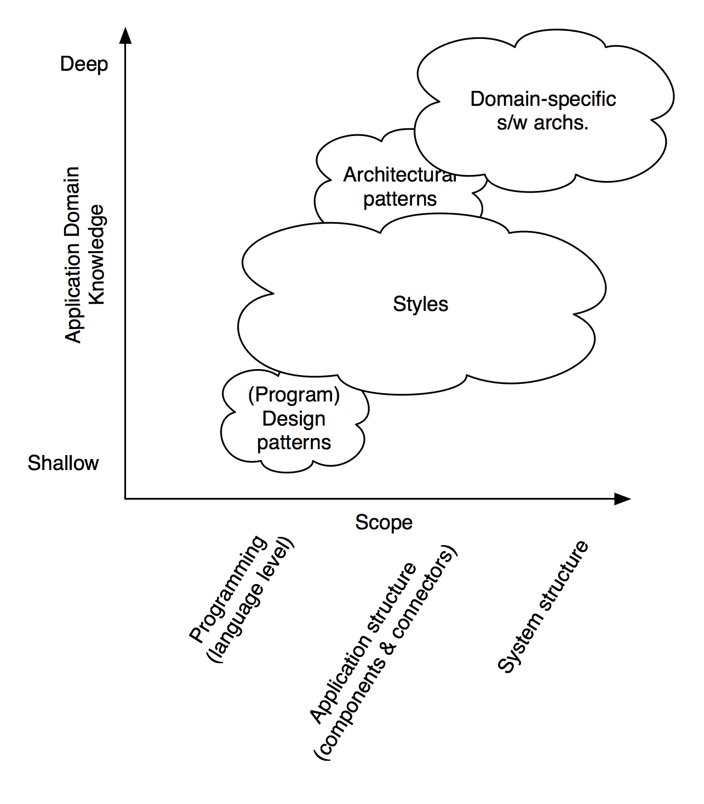
Patterns, Styles, and Domain Specific Software Architectures (DSSAs) [Tay10]
Software Architecture: Foundations, Theory, and Practice; Richard N. Taylor, Nenad Medvidovic, and Eric M. Dashofy; © 2008 John Wiley & Sons, Inc. Reprinted with permission.

Slide 8
Architectural Styles
An architectural style is a named collection of architectural design decisions that
are applicable in a given development context
constrain architectural design decisions that are specific to a particular system within that context
elicit beneficial qualities in each resulting system
A primary way of characterizing lessons from experience in software system design
Reflect less domain specificity than architectural patterns
Useful in determining everything from subroutine structure to top-level application structure

Slide 9
Some Common Styles
Traditional, language-influenced styles
Main program and subroutines
Object-oriented
Layered
Virtual machines
Client-server
Data-flow styles
Batch sequential
Pipe and filter
Shared memory
Blackboard
Rule based
Interpreter
Interpreter
Mobile code
Implicit invocation
Event-based
Publish-subscribe
Peer-to-peer
“Derived” styles
C2
CORBA

Slide 10
Producing secure or reliable systems

Slide 11
Middleware support for application architecture
General architecture styles: MVC, Broker, Pipes and Filters, Blackboard, N-tier architectures, Enterprise Service Bus
Support patterns: Publish/Subscribe, Adapter, Façade
Secure versions of them include Authentication, Authorization, Security Logger/Auditor
An application can use general styles and then add security using security patterns
The network must complement distribution security by protecting its channels

Slide 12
Middleware patterns

Slide 13
Broker
Intent
The Broker structures distributed systems with separate components that interact by remote service calls. A broker coordinates communications, including forwarding requests and sending back results and exceptions.
Forces
Components should be able to access remote services in a location-transparent way.
Components may need to be exchanged, added, or removed at execution time.
Implementation details should be hidden from the users of components and services.

Slide 14
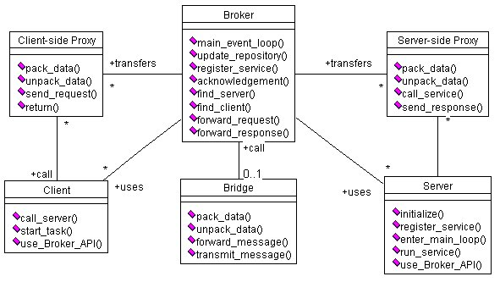
Class diagram of Broker

Slide 15
UCs: Register and Request Service

Slide 16
Known uses
CORBA
IBM’s SOM/DSOM
Microsoft’s DCOM, .NET Remoting
Sun’s Java RMI
This pattern (and the Layers and Lookup patterns) are used in the Bluetooth specification
WWW
Web services

Slide 17
Consequences
Advantages
Remote objects or units can be accessed transparently, as if they were local
Changeability and extensibility of components
Interoperability between different Broker systems
Portability of a broker system because low level details are hidden from users
Reusability
Liabilities
Error handling is difficult
Lower fault tolerance, single point of failure (can use replication)
Restricted efficiency (indirection)
Testing and debugging

Slide 18
Secure Broker: threats
Illegal access. Client access to servers may need to be restricted and server access to clients may need to be restricted for compliance and application semantics purposes.
Message interception or replaying. An attacker may intercept the messages from client to server and read or modify them. Message replaying is another possibility.
Spoofing (Forgery). If a rogue server can portray itself as valid to the Broker, it can appear to service client requests while also compromising client data, or perform a wide variety of other attacks on clients. Likewise, if a rogue Broker can portray itself as valid to Servers and Clients, it can do harm by recording traffic between clients and servers, substituting other clients and servers for valid ones, and so on. And if a client can forge its identity to a Broker, it can access services for which it does not have rights. There are a wide variety of attacks based on Forgery: redirection of traffic from official sites to forged sites; spamming while masking the source's destination; Cache Poisoning, where invalid entries are stored in the Broker's repository; and routing attacks, where traffic intended for one destination is sent to another.
Denial of Service. Valid entries in the repository could be removed, and they will not be accessible. And with access to the Broker's server repository, DoS attacks can be launched against member servers. By limiting the server’s abilities to respond to requests, clients can be disabled.

Slide 19
Securing a Broker

Slide 20
Outline (revised)
1. Motivation and overview. Distributed systems and security. Threats.
Review of basic aspects of security.
2. Security patterns. Other types of patterns. Reference architectures.
Review of UML. Security principles: sandboxing, isolation methods.
3. Threat analysis. Misuse patterns. Defenses. Authentication: OAuth,
Shibboleth. Authorization.
4. Methodologies for building secure distributed applications. Secure
Solution Frames. ASE. UMLSec, SecUML, Secure Tropos.
5. Security evaluation. Use of patterns and arguments. Common Criteria.
Evaluation, certification and attestation. Assignment 1
6 Distributed architectures. Secure versions of patterns: Broker, MVC,
Publish/Subscribe. Agents. P2P systems. Middleware. .
7. Security in cloud computing. Threats and defenses. Patterns and
misuse patterns. Access Control, Infrastructure security. OpenStack
security. Container security. Virtualization security. NFV. Cloud ecosystems.

Slide 21
Outline II
8 Cyber-physical systems. Threat modeling. Stuxnet. Security in smart
grid, vehicles, cargo ports, oil and gas pipelines, smart buildings. The
Internet of Things. Fog computing. Robotics. Assignment 2.
9. Networks. Sensor network security. Wireless clouds. Vehicular network
threats and defenses. Smart phone security
10. Web architectures. Attacks, and standards. Web
services patterns. Identity. Security standards: SAML, XACML. Misuse
patterns. REST security. Cloud ecosystems
11. New defenses. Analytics and AI to detect attacks. SIEM. Deception-based
defenses. Adaptive defenses.
12. Specialized architectures. Security in Blockchain architectures. Secure
Big Data architectures. AI-based systems.
13.Secure software development for clouds and IoT. DevOps, SecOps,
secure microservices.

Slide 22
Projects
You can send me your projects in progress and I can tell you if you are going in the right direction.
Projects, papers, and theses should be built incrementally and iteratively, same as developing software.
I start by the introduction, to define the scope of the paper, and some references. I also make a skeleton of section titles and fill them one by one (this is the incremental style). After finishing some section I go back to earlier sections and redo them (iterations).
In this way you can receive feedback, have time to digest the contents of relevant papers, and think about your ideas
Do not expect divine inspiration in the days right before the deadline

Slide 23
MVC pattern-- intent
The model contains the core functionality and data. Views display information to the user. Controllers handle user input.
Views and controllers together comprise the user interface.
A change-propagation mechanism ensures consistency between the user interface and the model.

Slide 24
Problem
User interfaces are especially prone to change requests. When you extend the functionality of an application, you must modify menus to access these new functions.
A customer may call for a specific user interface adaptation, or a system may need to be ported to another platform with a different ‘look and feel’ standard.
Even upgrading to a new release of your windowing system can imply code changes.
The user interface platform of long-lived systems thus represents a moving target.

Slide 25
Forces
The same information is presented differently in different windows, for example, in a bar or pie chart.
The display and behavior of the application must reflect data manipulations immediately.
Changes to the user interface should be easy, and even possible at run-time.
Supporting different ‘look and feel’ standards or porting the user interface should not affect code in the core of the application.

Slide 26
Class diagram of MVC

Slide 27
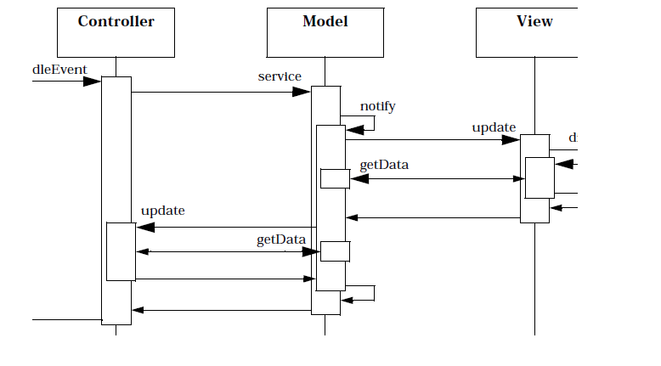
Propagating an event

Slide 28
MVC in the web
The model is the information in an application or the database
The controller is an instance of ASP or JSP that assembles information from the application or database
The views are the browser interfaces that are used to access data

Slide 29
Security requirements for MVC
Authenticity. We need to be sure that users who interact with our system are legitimate. Remote users will want to be sure that our system is authentic.
Confidentiality. We may need to restrict access to the Model's information only to some users or roles. Also some portions of the data in transit from the Model to the (remote) View must be protected against eavesdropping.
Integrity.We may want to allow only some users or roles to make changes to the Model, and only authorized changes.
Logs. The model may contain sensitive information and we want to have a record of all accesses to it.

Slide 30
Secure MVC

Slide 31
Data access in Secure MVC

Slide 32
Known uses of Secure MVC
The ASP .Net MVC framework provides authentication and authorization functionalities at the controller's method level. In addition, AntiXSSLibrary and HtmlSanitizationLibrary are two libraries that can be used for protecting against XSS (Cross-Site Scripting) attacks as well as CSRF or XSRF (Cross-Site Request Forgery) attacks.
The Struts web framework provides a Validation Framework, which is the primary method of validating a struts based application. Output sanitation is the process of ensuring that the output does not contain HTML or XML specific characters. In addition, roles can be mapped to ActionMapping objects, a Controller component, and authentication attributes can be specified. The framework supports multiple authentication schemes, such as password authentication, FORM-based authentication, authentication using encrypted passwords, and authentication using client-side digital certificates. SSL can be enabled as a secure transport layer.
Spring Web MVC framework offers similar security features.

Slide 33
Publish Subscribe
Intent: Decouple the publishers of events from those interested in the events (subscribers).
Problem: Having each client call a publisher is inefficient and non-scalable. Also, more than one client could be interested in the events.
The number of clients is dynamic
Solution
Use an event channel (a queue) where publishers send their events and interested subscribers can receive the events. For event transmission it is possible to use push and pull approaches

Slide 34
Distributed P/S
Intent: In a distributed system, decouple the publishers of events from those interested in the events (subscribers).
Context: Distributed applications using web services, as well as related services such as directories, databases, security, and monitoring. There may be also other types of components (J2EE, .NET). There may be different standards applying to specific components and components that do not follow any standards.
Problem: Having each client call a publisher to find out if they have something of interest to them is inefficient and non-scalable. Also, more than one client could be interested in the same events. How do we organize publishers and subscribers in a more efficient way?

Slide 35
Solution
Use an event channel where publishers send their events and interested subscribers can receive the events. Subscribers register for the events on which they are interested.
Structure Subscribers can register to receive specific events. Their conditions are described in the class Subscription. The Channel represents different ways of publishing events.
Dynamics Figure 6 shows a sequence diagram for the use case Publish Event. Other use cases include Register Subscriber and Remove Subscriber.

Slide 36
Dist. P/S class diagram

Slide 37
UC: Publish an event

Slide 38
Implementation
For event transmission it is possible to use push and pull approaches
The event channel can be any type of asynchronous channel and may use an ESB.
Subscribers usually receive only a subset of the total messages published. The process of selecting messages for reception and processing is called filtering. There are two common forms of filtering: topic-based and content-based.

Slide 39
Known uses
The IBM MQSeries provides guaranteed, once-only delivery of messages between IT systems. It can connect different types of platforms, including those from IBM, Microsoft, Sun, and HP using a variety of communications protocols
Software AG has an Integrator Server that distributes documents using a Broker as publishing channel
Oracle uses Publish/Subscribers in conjunction with their database architectures

Slide 40
Variants
If we add security mechanisms we can define a Secure Publish/Subscriber which uses the Secure Channel pattern for event channel, uses RBAC pattern for control of contents, provides mutual authentication, and includes logging.
There are variants based on the type of service provided: topic-based, content-based, concept-based, and type-based.
We can also define a P/S focusing on its functional or conceptual aspects, not in its software realization as we have done here. That is an style.

Slide 41
Advantages
Interoperability. Because of its decoupling effect, this pattern allows the interaction of any type of publishers and subscribers.
Freedom: Subscribers only need to register to receive some events; after this they can go on their own businesses and they are notified when there is something new.
Dynamicity: We can add or remove subscribers at any time. Subscribers can also change their interests by changing their type of subscription.
Scalability: The number of subscribers can be extended by just extending the subscriber list as far as we have appropriate communication channels for the events.

Slide 42
More advantages
Loose coupling: Publishers can work without knowledge of their subscriber details and vice versa. As far as their interfaces remain constant, both can change independently.
Location Transparency: Neither subscribers nor publishers need to know each other’s locations, a lookup service can find their locations.
Security: if events are sensitive we can encrypt the event channel. We can also use digital signatures for authenticity. See the description of the Secure P/S variant.
Selectivity: it is possible for the clients to select the published events according to different criteria, e.g., topic-based, content-based, concept-based, and type-based [Cor06].
Role changing: Publishers and subscribers may be just roles that can be taken by any entity.

Slide 43
Liabilities
There is some overhead in the event structure,, i.e. a tight coupling of subscribers to their publishers would have better performance at the cost of flexibility.
There may be coordination problems because of the decoupling.

Slide 44
Secure P/S

Slide 45
Secure Pipes and Filters [Fer09]
The Secure Pipes and Filters pattern provides secure handling of data streams. Each processing step applies some data transformation or filtering. The rights to apply specific transformations to the data can be controlled. The communication of data between stages can be also protected. The operations applied can be logged.

Slide 46
Secure Pipes and Filters object diagram

Slide 47
UC “Apply an operation on a data stream”

Slide 48
Blackboard
A Blackboard system is used to receive and modify information about a problem in progress from several data sources. The execution platform for this kind of system is normally distributed, with knowledge sources possibly remote. The data is exchanged between blackboard and knowledge sources in a client/server fashion.

Slide 49
Object diagram of Blackboard pattern

Slide 50
Secure Blackboard [Ort08]
The Secure Blackboard pattern provides secure handling of data when its blackboard is accessed by some knowledge sources. Each knowledge source reads data from the blackboard, applies some processing or data transformation, and updates the blackboard.
In order to prevent violations of integrity and confidentiality, the rights to reading and updating data are controlled according to their predefined rights and their actions are logged.
The sources are authenticated before being allowed to access the blackboard.

Slide 51
Secure Blackboard

Slide 52
Use case “Apply an operation on the Blackboard”

Slide 53
Secure Three-Tier Architecture Pattern
The Three-Tier Architecture pattern provides a means of structuring and decomposing applications into tiers or layers, where each tier provides a different level of responsibility. One tier deals with the presentation part of the system (user and system interfaces), another handles the business logic, being the core of the system, and the last tier represents the data storage.
The Secure Three-Tier Architecture pattern extends the Three-tier Architecture pattern by enforcing a global view of security for all the three layers. In the presentation part of the system, security aspects dealing with user interaction are enforced; in the business logic, global security constraints are applied; the data storage applies policies to constrain access of users to data.

Slide 54
Secure Three-tier (N-tier in general)

Slide 55
Enterprise Service Bus (ESB) pattern [Fer11]
Components connect to a variety of message bus via their service interfaces
Extension: Internet Service Bus
A SOA Registry (repository, catalog), is used for service description, naming, location, It includes Registry, Activator, and Lookout patterns

Slide 56
ESB pattern
Intent: Provide a convenient infrastructure to integrate a variety of distributed services and related components in a simple way.
Forces:
Interoperability. It is fundamental for a business unit in an institution to be able to interact with a variety of services, internal or external.
Simplicity of structure: we want a simple way to interconnect services; this simplifies the work of the integrators.
Scalability: we need to have the ability to expand the number of interconnected services without making changes to the basic architecture.
Message flexibility: we need to provide a variety of message invocation styles (synchronous and asynchronous) and formatting. We can thus accommodate all component needs.

Slide 57
Forces (Cont.)
Simplicity of management: we need to monitor and manage many services, perform load balancing, logging, routing, format conversion, and filtering.
Flexibility: New types of services should be accommodated easily.
Transparency: we should be able to find services without needing to know their locations.
Quality of service: we may need to provide different degrees of security, reliability, availability, or performance.
Use of policies: we need a policy-based configuration and management. This allows convenient governance and systematic changes. Policies are high-level guidelines about architectural or institutional aspects and are important in any system that supports systematic governance [Sch06].
Standard interfaces: we need explicit and formal interface contracts.

Slide 58
ESB structure

Slide 59
ESB class model

Slide 60
ESB service access

Slide 61
ESB related patterns

Slide 62
Support patterns
Provide auxiliary functions in an application

Slide 63
Security Logger and Auditor
Intent
How can we keep track of user’s actions in order to determine who did what and when?
Log all security-sensitive actions performed by users and provide controlled access to records for Audit purposes.
Variants
Most systems have a System Logger, used to undo/rollback actions after a system crash. That type of Logger has different requirements but sometimes is merged with the Security Logger [SAP01]. System logs are of interest to system and database administrators, while security logs are used by security administrators, auditors, and system designers.
Another variant could include the automatic rising of alarms by periodic examination of the Log, searching records that match a number of rules that characterize known violations. For example, Intrusion Detection Systems use this variant.
We can also add logging for reliability, to detect accidental errors.

Slide 64
Class diagram of Logger/Auditor

Slide 65
Adapter (www.vico.org)
Intent: The Adapter pattern converts the interface of an existing class into a more convenient interface, expected by a client.
Also Known As: Wrapper
Applicability: An existing class may have an interface that doesn’t match a new application. We may make its interface look like the new application by adapting it. Now the clients see a class according to the new application; calls to that interface are passed over to the old class.
GOF book gives sample code.

Slide 66
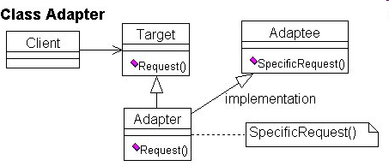
Class Adapter

Slide 67
Façade
Intent: Provide a unified higher-level interface to a set of interfaces in a subsystem.
Applicability: Use Façade when you want to provide a simple interface to a complex object-oriented subsystem or you want an entry point to a layer in a layered system.

Slide 68
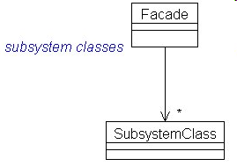
Façade class diagram

Slide 69
Consequences
Shields clients of details from subsystem units
Units in the subsystems can vary without affecting clients
Can improve security and reliability by hiding implementation details

Slide 70
References
[Bus96] F. Buschmann, R. Meunier, H. Rohnert, P. Sommerland, and M. Stal., Pattern-oriented software architecture, Wiley 1996.
[Sch95] D.C. Schmidt, “Using design patterns to develop reusable object-oriented communication software”, Comm. of the ACM, vol. 38, No 10, October 1995, 65-74.
[Sch99] D.C. Schmidt and C. Cleeland, “Applying patterns to develop extensible ORB middleware”, IEEE Comm. Mag., April 1999, 54-63.
[Sch00] D. C. Schmidt, M. Stal, H. Rohnert, and F. Buschmann, Pattern-Oriented Software Architecture,” Wiley 2000.

Slide 71
References
[Ort08] J. L. Ortega-Arjona and E.B.Fernandez, "The Secure Blackboard pattern". Procs. of the 15th Int.Conference on Pattern Languages of Programs (PLoP 2008), co-located with OOPSLA, Nashville, TN, Oct. 2008. http://www.matematicas.unam.mx/jloa/publicaciones/secureBlackboard.pdf
[Fer09] E.B.Fernandez and J. L. Ortega-Arjona, "The secure Pipes and Filters pattern", Procs.of the Third Int Workshop on Secure System Methodologies using Patterns (SPattern 2009). http://www.matematicas.unam.mx/jloa/publicaciones/PipesFiltersMay22-09.pdf
E. B. Fernandez and J. L. Ortega-Arjona, "Securing the Adapter pattern" , Procs. of the OOPSLA MiniPLoP, October 26, 2009
[Fer11] Eduardo B. Fernandez, Nobukazu Yoshioka, and Hironori Washizaki "Two patterns for distributed systems: Enterprise Service Bus (ESB) and Distributed Publish/Subscribe", 18th Conference on Pattern Languages of Programs (PLoP 2011) doi>10.1145/2578903.2579146
[Tay10] Taylor, R.N., Medvidovic, N., and Dashofy, N. Software architecture: Foundation, theory, and practice, Wiley, 2010.

